Slide 1
SQL (and Node.js)

Slide 2
SQL

Slide 3
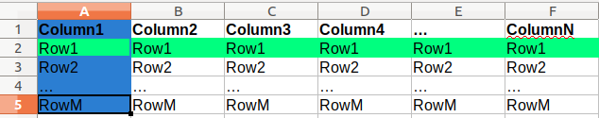
A Relational Database
Relational Database: A method of structuring data as tables associated by shared attributes
A table row corresponds to a unit of data called a record; a column corresponds to an attribute of that record
In Excel-speak:
In the above image, the cells highlighted blue are the first "column" and the cells highlighted green are of the first "row" (or "record", or "tuple")
Tables can be visualized just like an Excel sheet, just with different terminology, and more programmatic capabilities.

Slide 4
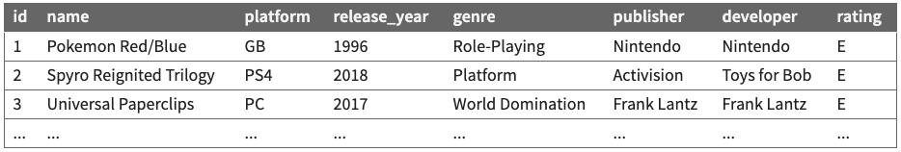
Example Database

Slide 5
Structured Query Language (SQL)
A "domain-specific language" (HTML is also a DSL) designed specifically for data access and management.
Also like HTML, SQL is a declarative language: describes what data you are seeking, not exactly how to find it.
In SQL, you write statements. The main different types of statements we'll look at:
Data Definition: Generally, what does your data look like?
Data Manipulation: Change or access the data.
(There are others, but we won't be talking about them.)

Slide 6
SQL Basics
SELECT name FROM menu WHERE qty > 0;
INSERT into menu (name, category, qty, image)
VALUES ("Cookie", "Desserts", 154, "cookie.png");
Structured Query Language (SQL): A language for searching/updating a database.
A standard syntax that is used by all database software (with minor variations). Generally case-insensitive.

Slide 7
Some Basic SQL Statements
SELECT
DISTINCT
WHERE
LIKE
ORDER BY
LIMIT
These are the basic "building-blocks" of forming "questions" (queries) in SQL

Slide 8
Example Database

Slide 9
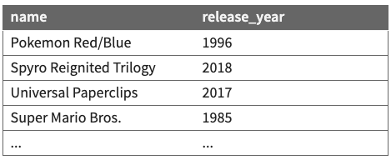
The SQL SELECT Statement
Syntax:
SELECT column(s) FROM table;
Example:
SELECT name, release_year FROM Games;
Example output:
The SELECT statement is used to return data from a database.
It returns the data in a result table containing the row data for column name(s) given. Table and column names are case-sensitive.

Slide 10
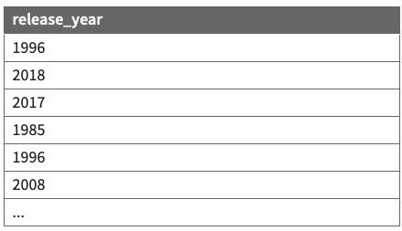
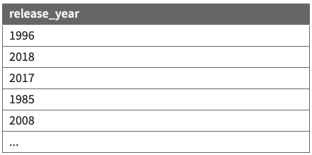
The DISTINCT Modifier
Syntax:
SELECT DISTINCT column(s) FROM table;
The DISTINCT modifier eliminates duplicates from the result set.
Example (without DISTINCT):
Example (with DISTINCT):
SELECT release_year
FROM Games;
SELECT DISTINCT release_year
FROM Games;

Slide 11
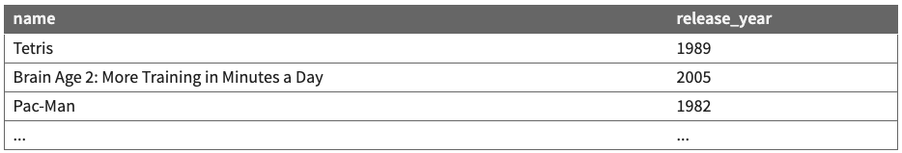
The SQL WHERE Statement
Syntax:
SELECT column(s) FROM table WHERE condition(s);
Example:
SELECT name, release_year FROM Games WHERE genre = 'puzzle';
Example output:
The WHERE clause filters out rows based on their columns' data values. In large databases, it's critical to use a WHERE clause to reduce the result set in size.
Suggestion: When trying to write a query, think of the FROM part first, then the WHERE part, and lastly the SELECT part.

Slide 12
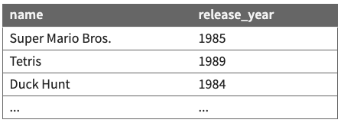
More about the WHERE Clause
Syntax:
WHERE column operator value(s)
Example:
The WHERE portion of a SELECT statement can use the following properties:
=, >, >=, < <=
<> or != (not equal)
BETWEEN min AND max
LIKE pattern
IN (value, value, ..., value)
SELECT name, release_year
FROM Games
WHERE release_year < 1990;
Example result:

Slide 13
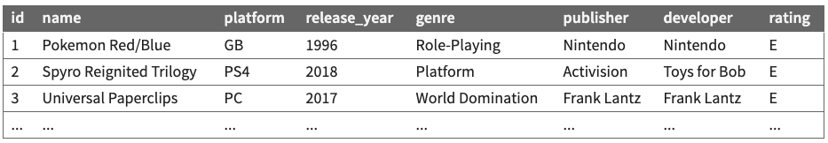
Check your Understanding
Write a SQL query that returns the name and platform of all games with a release_year before 2000.
SELECT name, platform
FROM Games
WHERE release_year < 2000;

Slide 14
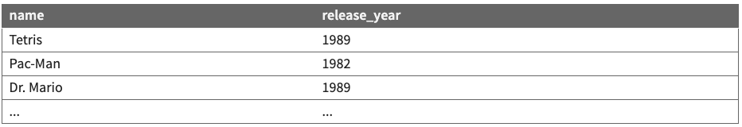
Multiple WHERE Clauses; AND, OR
Example:
SELECT name, release_year FROM Games
WHERE release_year < 1990 AND genre='puzzle';
Example output:
Multiple WHERE conditions can be combined using AND or OR.

Slide 15
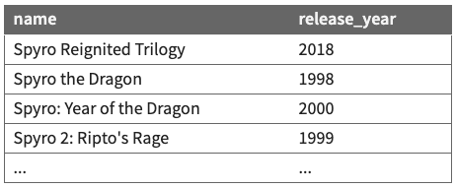
Approximate Matches with LIKE
Syntax:
WHERE column LIKE pattern
Example:
LIKE 'text%' searches for text that starts with a given prefix
LIKE '%text' searches for text that ends with a given suffix
LIKE '%text%' searches for text that contains a given substring
Note: In SQLite, the text in the LIKE string is case-insensitive.
SELECT name, release_year
FROM Games
WHERE name LIKE 'Spyro%'
Example result:

Slide 16
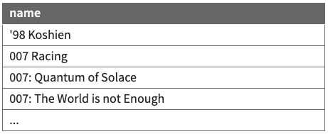
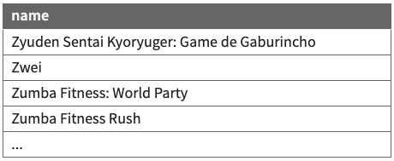
Sorting By a Column: ORDER BY
Syntax:
SELECT column(s) FROM table
ORDER BY column(s) ASC|DESC;
Example (ascending order by default):
Example (descending order):
SELECT name FROM Games
ORDER BY name
SELECT name FROM Games ORDER BY name DESC;
The ORDER BY keyword is used to sort the result set in ascending or descending order (ascending if not specified)

Slide 17
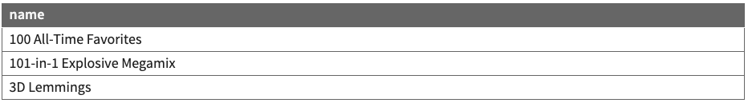
Limiting Rows with LIMIT
Syntax:
LIMIT number
Example:
SELECT name FROM Games
WHERE genre='puzzle'
ORDER BY name
LIMIT 3;
Example result:
LIMIT can be used to get the top-N of a given category. It can also be useful as a sanity check to make sure you query doesn't return 100000 rows.

Slide 18
Check your Understanding
Write a SQL query that returns the name and platform of all games with the word ‘dragon’ in them, ordered by release_year.
SELECT name, genre
FROM Games
WHERE name LIKE '%dragon%'
ORDER BY release_year;

Slide 19
Additional Practice with SQL Queries
SQLZoo has multiple exercises (with built-in databases you don't need to worry about setting up) for practicing SELECT, WHERE, ORDER BY, LIMIT, LIKE, etc. We recommend you go through these for additional practice!

Slide 20
The Node.js and SQL Connection

Slide 21
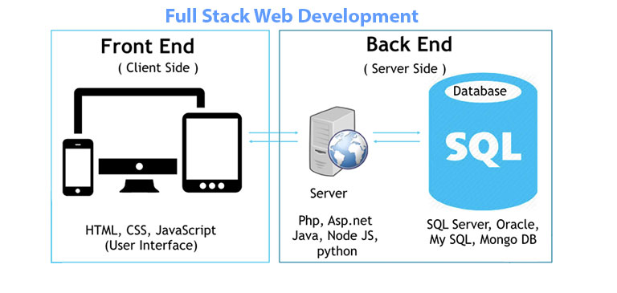
Full-stack website organization
A full-stack website consists of three layers:
Web Browser (client): HTML, CSS, JS
Web Server: Node.js
Database Server: SQL
The web server makes requests of the database server much like our client-side JS used AJAX
The sqlite module will handle most of this for us.

Slide 22
sqlite vs sqlite3
sqlite3 is the most popular module used to connect to a SQLite database in Node.js
Similar to the fs module, sqlite3 functions use callbacks for results and errors
We will use sqlite which is a wrapper for sqlite that adds promises

Slide 23
Using SQL in Node.js
First install the sqlite3 and sqlite modules in your project.
npm install sqlite3 sqlite
Then require both modules with the rest of your modules in your Node.js program.
const sqlite3 = require("sqlite3");
const sqlite = require("sqlite");

Slide 24
SQL Connection
'use strict';
const sqlite3 = require('sqlite3');
const sqlite = require('sqlite');
* Establishes a database connection to the wpl database and returns the database object.
* Any errors that occur during con. should be caught in the function that calls this one.
* @returns {Object} - The database object for the connection.
*/
async function getDBConnection() {
const db = await sqlite.open({
filename: 'data/wpl.db',
driver: sqlite3.Database
});
return db;
}

Slide 25
Executing SQL queries with the db object
Once you have the db object, you can now execute SQL queries with db.all
This function takes a SQL query string and an optional array of parameters/placeholder values and returns the resulting rows.
let rows = await db.all(sqlString)
let rows = await db.all("SELECT name, category FROM menu ORDER BY name;");

Slide 26
More about db.all(sqlString)
The query function returns an array of JS objects, which represent information for each row matching the query. In the below example, we limit at most 2 rows in the result.
let qry = "SELECT name, type FROM pokedex LIMIT 2;";
let rows = await db.all(qry);
console.log(rows);
[
{ name: 'Bulbasaur', type: 'grass' },
{ name: 'Ivysaur', type: 'grass' }
]

Slide 27
Extracting the data
The column (field) names for each row (record) can be accessed using dot notation (it's just an object!)
...
let qry = "SELECT name, type FROM pokedex LIMIT 2;";
let rows = await db.all(qry);
let firstRow = rows[0];
console.log("Name: " + firstRow.name + "(" + firstRow.type + ")");
Name: Bulbasaur (grass)
Note that only the column names specified in the SELECT statement will be accessible (for this example, name and type)

Slide 28
try/catch
Database connections can have different problems: the database server could be down, the database could be missing or corrupted, the user/password credentials may be incorrect.
You can find a good review of SQLite error codes here - useful when you are debugging and/or want to handle errors differently (similar to how we can use err.code === "ENOENT" in our response logic)
try/catch helps us catch and identify when errors occur so we can handle the error correctly.

Slide 29
Using try/catch with sqlite functions
You can try/catch just like you would for fs.readFile(), catching any errors that occur in the db.all function.
try {
let rows = await db.all("SELECT name FROM pokedex"); // error could happen here
// process the result rows somehow
} catch (error) {
res.status(500).send("Error on the server. Please try again later.");
}

Slide 30

Using SQL in Node
In order to connect and open our database so that we have access to query the tables, we need to include the lines of code below. Remember to also npm install so that your package.json is updated with the proper dependencies
// top of app.js
const sqlite3 = require('sqlite3');
const sqlite = require('sqlite');
// somewhere in your app.js (after all // endpoint definitions)
async function getDBConnection() {
const db = await sqlite.open({
filename: '<db-file-name>.db',
driver: sqlite3.Database
});
return db;
}
Make sure to replace this with
the name of your database file!

